Slide 1
HOLOCAUST

Slide 2
TIMELINE
Post World War I - Lives of Jews Before the Holocaust
1933 - Legal Violence
1934 - Ghettoisation begins
1938 - Kristallnacht
1933-1945 - Labour Camps
1941 - The Final Solution
1941 - Concentration Camps
1945 - End of Holocaust

Slide 3
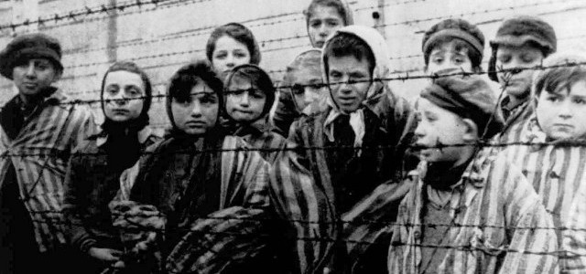
INTRODUCTION TO HOLOCAUST
Genocide
WWII
Nazi came to power in 1933 - Hitler
Anti-Semitism
Jews- a race not religious group (Untermenschen)
Notes:
Shoah-catastrophe. b/w 1940-45. Jews an evil race.

Slide 4
LIVES OF JEWS BEFORE HOLOCAUST
Jews originated as an ethnic and religious group from the Land Of Israel
Since the Middle Age they lived in Poland
The Statute of Kalisz provided legal protection
14th Century - 80% Jews lived in Poland
18th Century Poland was partitioned - Russia , Prussia , Artica
19th Century - the assassination of Russian Tsar Alexander II , Russian-Polish Jews were exposed to a series of organized massacres targeting Jewish communities called Pogroms.
World War 1 - Poland became a democratic and Independent State

Slide 5
September 1791 - Jews emancipated in France
The term "emancipation of Jews" means the removal of all legal discrimination against Jews and the granting of rights equal to those of other citizens in a country.
European Jewry remained beset by antisemitism and social discrimination.
March 9, 1936 - Pogrom in Przytyk, Poland
Three Jews are killed and more than sixty wounded in the town of Przytyk,
Poland. In the days following the attack, the pogrom spreads to neighboring
towns. Before the pogrom is ended, almost 80 Jews are killed and over 200
wounded. Violence against Jews was widespread throughout central Poland
between 1935 and 1937.

Slide 6
Legal Violence
Legal Violence was a technique of dominating the masses from above, it also included the ministerial bureaucracy, the armed forces, the industrial and agrarian leadership and other ways by which Nazi party aimed to dominate German society by using violence. Nazi Germany was violent, to a striking degree, when compared to other non-democratic regimes in the twentieth century. The impact of Nazi violence has been described thoroughly, primarily focusing on the terror and brutality of the Gestapo and the SS(Nazi Party agencies).

Slide 7
Anti-Jewish Violence by Nazi Party
1. The April Boycott and the Party Revolution from Below, 1933-1935 i) The first wave of anti-Jewish violence by the Nazi party, its divisions and affiliates, was launched right after the elections of March 5, 1933. ii)The Nazi party’s major goal was to push forward anti-Jewish legislation in the economy. iii)This became quite clear when Hjalmar Schacht, Reich Minister of Economics, on August 20, 1935, called for a conference to stop the Nazi party's riots. At this conference the representative for the party leadership, Adolf Wagner, proposed to ban Jews from public contracts and to forbid them to found enterprises and businesses. iv)During his final speech at the Nuremberg party congress on September 15, 1935, Hitler announced the “Nuremberg Laws,” which deprived the Jews of their citizenship and aimed at their virtual elimination from social life in Nazi Germany.

Slide 8
2. Party Bureaucracy and Violence Against the Jews, 1936-1937 i) After the party congress of 1935, the Nazi party’s anti-Jewish violence concentrated on excluding Jews from economic life. These efforts encompassed the destruction of the so-called “Jewish Economy” and the “Aryanization” of Jewish-owned businesses and enterprises. ii)Between 1936 and 1938, the Nazi party's functionaries made constant efforts to instigate “popular anger“ against Jews. They tried to increase the number of party members taking part in anti-Jewish actions, including violent acts. 3. Forms and Functions of the Nazi Party's Anti-Jewish Violence, 1933-1939 i)The anti-Jewish violence of the Nazi party after 1933 was directed to four different types of actions: the direct physical maltreatment of Jews and “non-Aryans”; the damage of Jewish property; the boycott of Jewish enterprises; and the appropriation of Jewish possessions. ii)In 1935-36, the Nazi party succeeded in the courts to represent the violence against the Jews as the “official duties” of its members. As a result, violent acts against Jews were accepted from the rule of the law.

Slide 9
Kristallnacht/“Night of Broken Glass”
Violent state-sponsored pogrom authorized by Adolf Hitler
Germany and Austria on November 9 and 10, 1938
Over 250 synagogues burned, 7,000 Jewish-owned businesses plundered and destroyed
Known Kristallnacht for the shattered glass from the store windows and the windows of synagogues and homes that littered the streets.

Slide 10
The Morning After
30,000 German Jewish men arrested for the "crime" of being Jewish
Sent to concentration camps
Businesses owned by Jews not allowed to reopen unless managed by non-Jews
Curfews placed on Jews
Difficult for children and teenagers:
Barred from entering museums, public playgrounds, and swimming pools
Expelled from the public schools
Youngsters were segregated in Germany

Slide 11
Key Dates
October 1938: Germany expels Polish Jews
About 17,000 Polish Jews expelled by Germany
Polish government refused to admit the deported Jews (the Grynszpan family among them)
Stateless and stuck along the Poland-Germany frontier regions
November 7, 1938: German diplomat shot in Paris
Herschel Grynszpan: 17-year-old Polish Jew living in Paris
Sought revenge for his family's precarious circumstances
Ernst vom Rath, a diplomat attached to the German embassy
The Nazis use the shooting to fan anti-semitic fervor (part of a wider Jewish conspiracy)

Slide 12
November 9, 1938: Joseph Goebbels demands radical action
German propaganda minister Joseph Goebbels delivered anti-semitic speech
Nazi officials ordered SA and other party formations to attack Jews
November 12, 1938: Nazis fine Jewish community
The Nazi state imposes a fine of one billion Reichsmarks ($400,000,000)
Ordered to clean up and make repairs and barred from collecting insurance for the damages
Aftermath of the pogrom
Excluded from all areas of public life
Only two of the German criminals were punished for raping Jewish women
At least 91 Jews were dead between 9 and 10 November

Slide 13
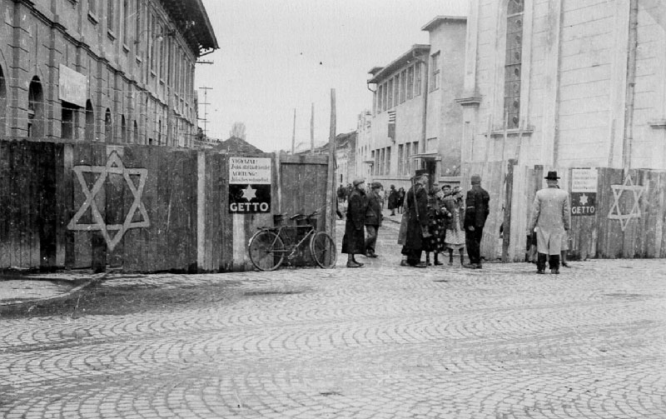
GHETTOISATION
Was a short term measure taken
Segregating Jews from the rest
Had established over 1000 ghettos
Jews died in ghettos due to diseases, hunger, randomly shooting

Slide 14
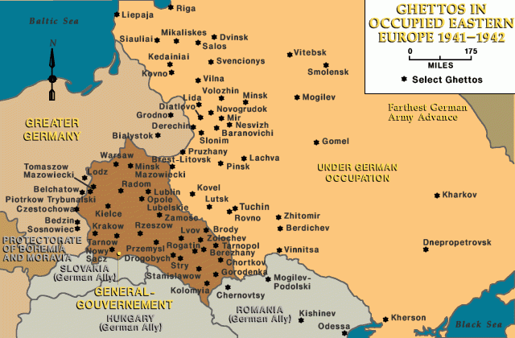
The Ghettos

Slide 15
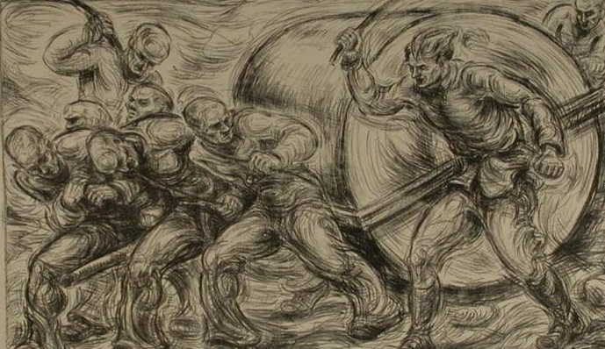
Labour and Extermination Camps
Labour camps
Extermination camps
Dehumanisation
Food and living conditions
Kity Hart-Moxon
Meta Doran

Slide 16
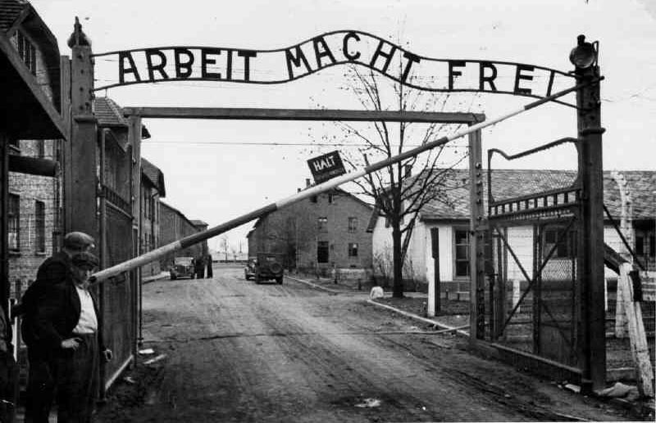

Slide 17
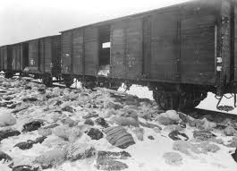
The Final Solution
Nazis were successful in alienating the Jews
Transportation of the Jews from Labour Camps and Ghettos to the Gas Chambers
Extermination of the race
Notes:
By making use of labour camps and Ghettos. Later the ghettos were shut down.
Transported 1000s of Jews by congested trains to the concentration camps
Wanted to get rid of sick Jews, so they shot them on spot. Young Jews in the labour camps were exploited for free work and then sent to the gas chambers

Slide 18
CONCENTRATION CAMPS
What are concentration camps?
Concentration camps in Nazi Germany
Erected in March 1933
Aim of the concentration camps
Hitler’s ascend as Chancellor.
People captivated
Statistics of the prisoners

Slide 19
CONCENTRATION CAMPS IN WORLD WAR II
Millions were tortured and killed.
Total population
Prisoners & their identification
Treatment
Liberation
Post World War II
Historians categorization of Concentration Camps

Slide 20
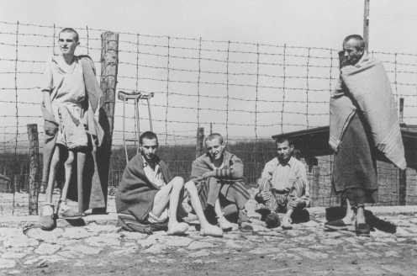
Report by BBC War Correspondent
Here over an acre of ground lay dead and dying people. You could not see which was which. ... The living lay with their heads against the corpses and around them moved the awful, ghostly procession of emaciated, aimless people, with nothing to do and with no hope of life, unable to move out of your way, unable to look at the terrible sights around them ... Babies had been born here, tiny wizened things that could not live. ... A mother, driven mad, screamed at a British sentry to give her milk for her child, and thrust the tiny mite into his arms. ... He opened the bundle and found the baby had been dead for days. This day at Belsen was the most horrible of my life. — Richard Dimbleby, 15 April 1945

Slide 21
End of Holocaust
The Final Solution moved into its last stages as Allied forces began to close in on Germany in 1944.
Prisoners remaining in Auschwitz and other concentration camps were transported or force-marched to camps within Germany which is referred to as the death march.
When British troops came across the camp on 15 April 1945, they encountered 10,000 unburied corpses, a raging typhus epidemic and 60,000 sick and dying prisoners crammed into overcrowded barracks without food or water.
It officially ended when Germany surrendered on May 8 1945.

